Slide 1

Data visualization: related to health

Slide 2
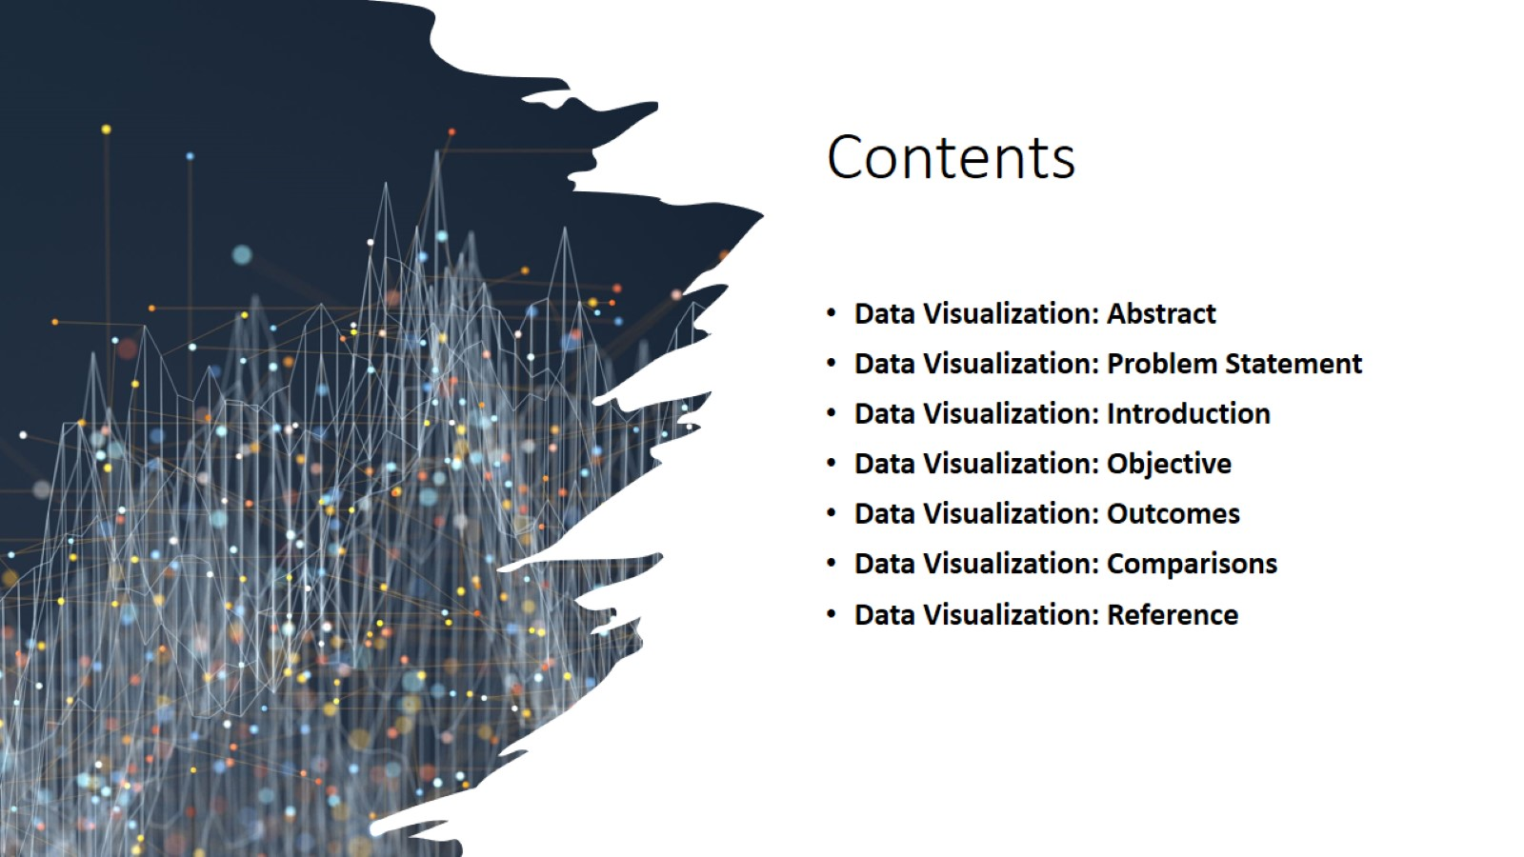
Contents

Slide 3

Abstract

Slide 4
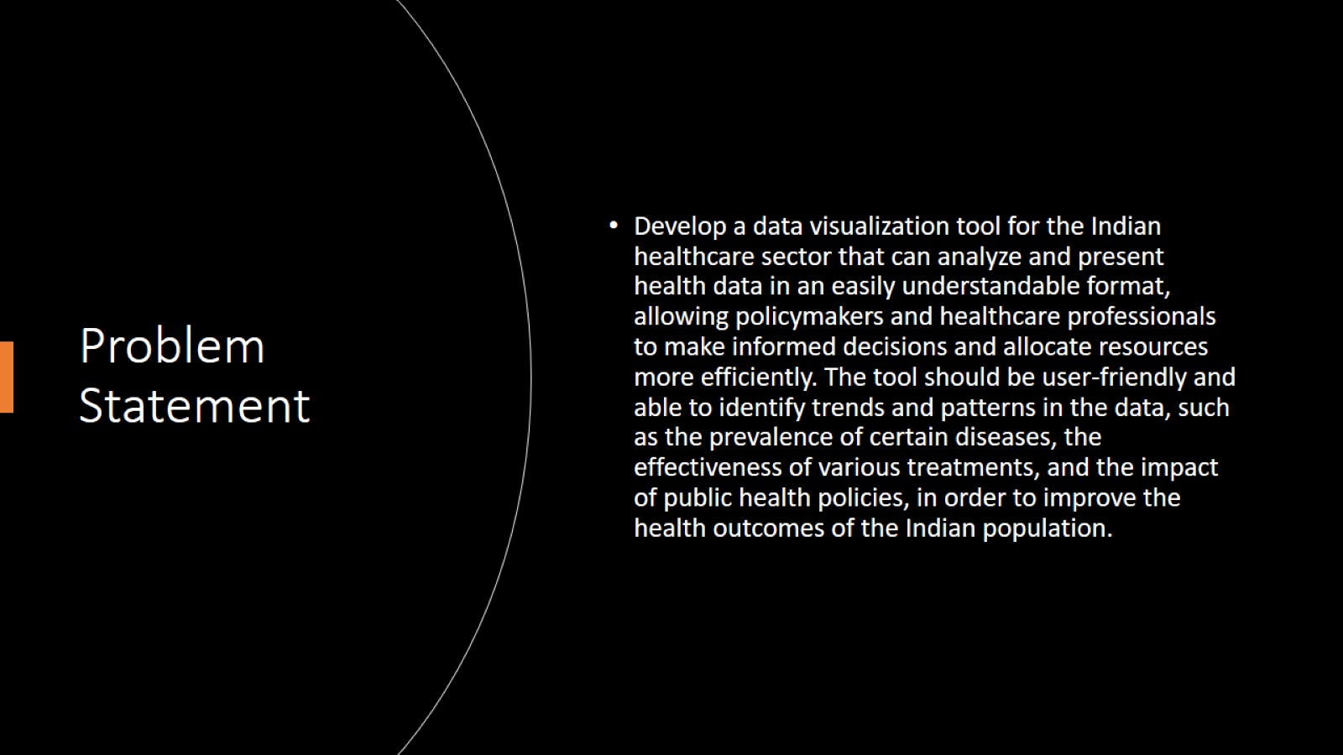
Problem Statement

Slide 5

Introduction

Slide 6


Slide 7
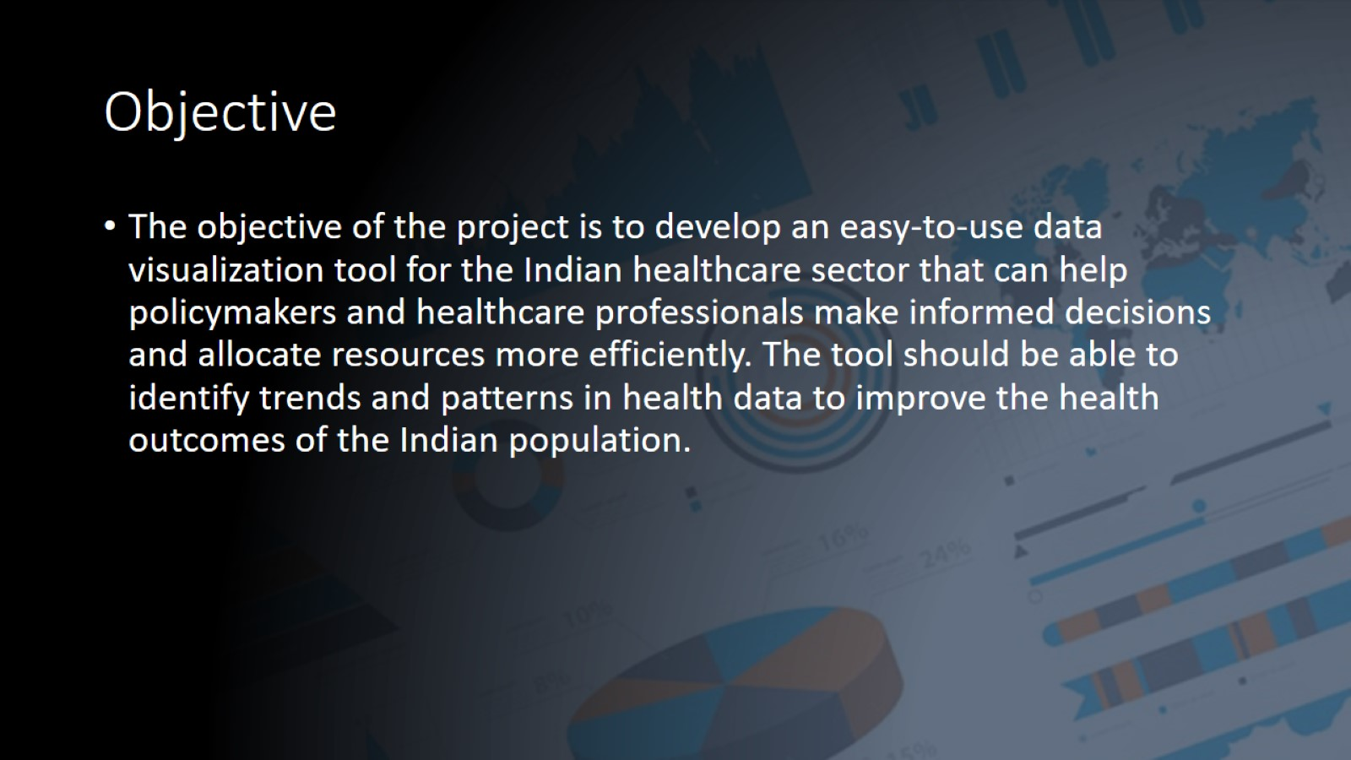
Objective

Slide 8
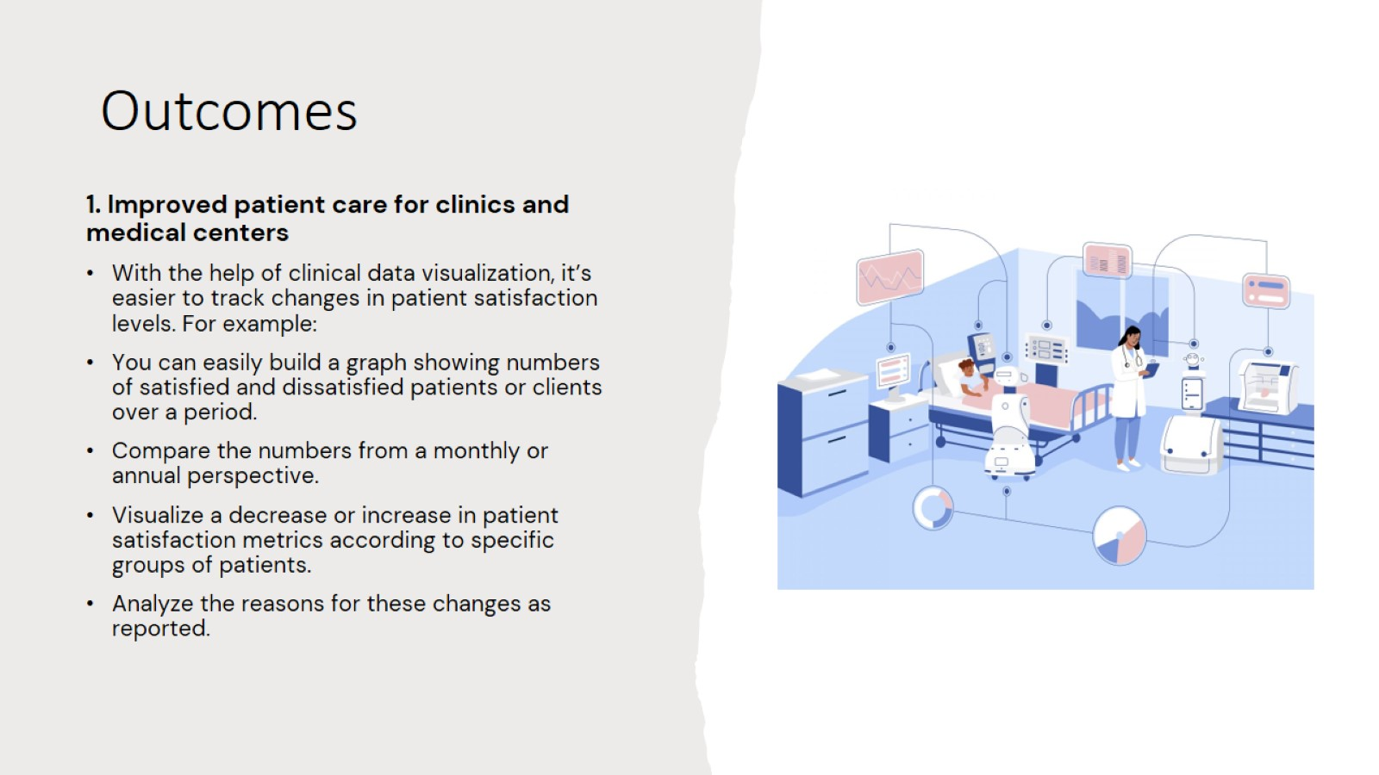
Outcomes

Slide 9


Slide 10
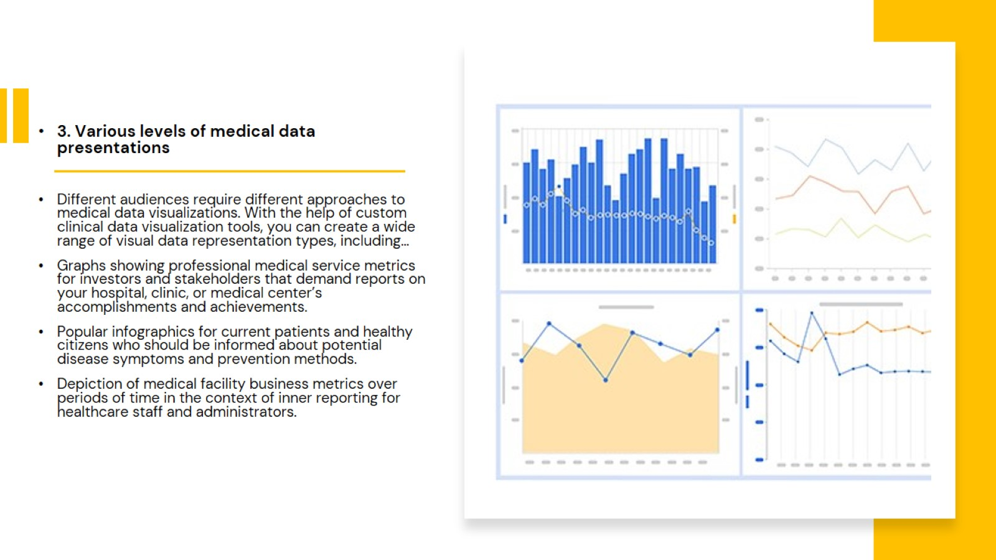

Slide 11
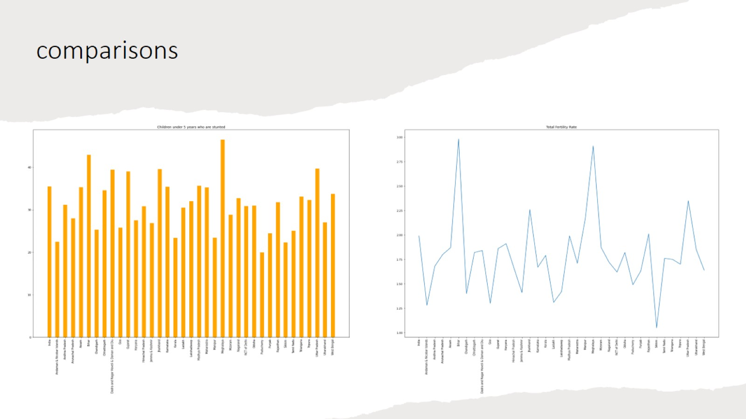
comparisons

Slide 12
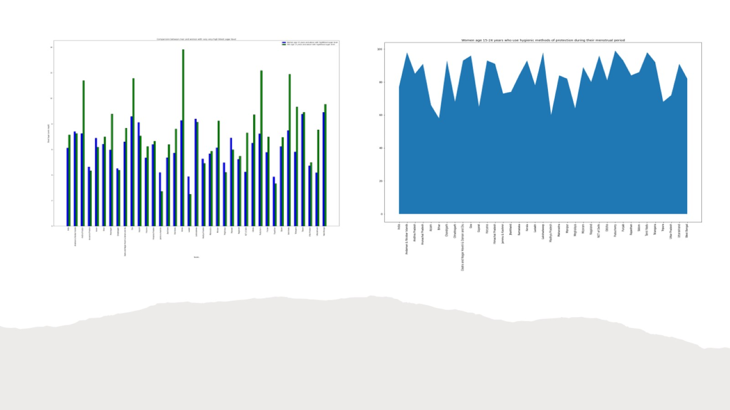

Slide 13

Reference

Slide 14
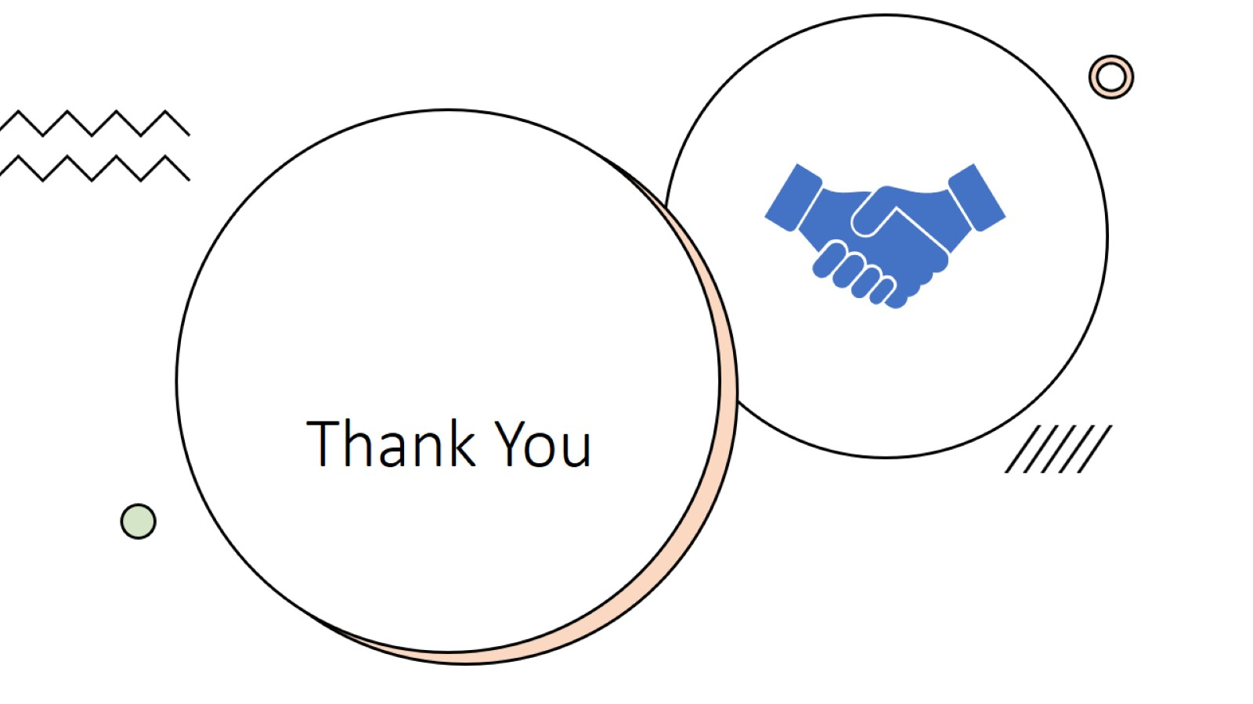
Thank You

